Slide 1
Public Information Meeting 40th Street Improvement Project From Industrial Avenue to East City Limits
January 15, 2026

Slide 2



Slide 3
Introductions / Project Team
Andrew Bisaha - City of Holland
Bruce Carlstrom – Holland Board of Public Works
Lynnelle Berkenpas – Spaulding DeDecker
Matt Hill - WSP

Slide 4
Meeting Agenda:
Project Details
Location Map / Project Limits
Scope
Funding
Expectation During Construction
Project Schedule (Tentative)
Question & Answer
One on One

Slide 5
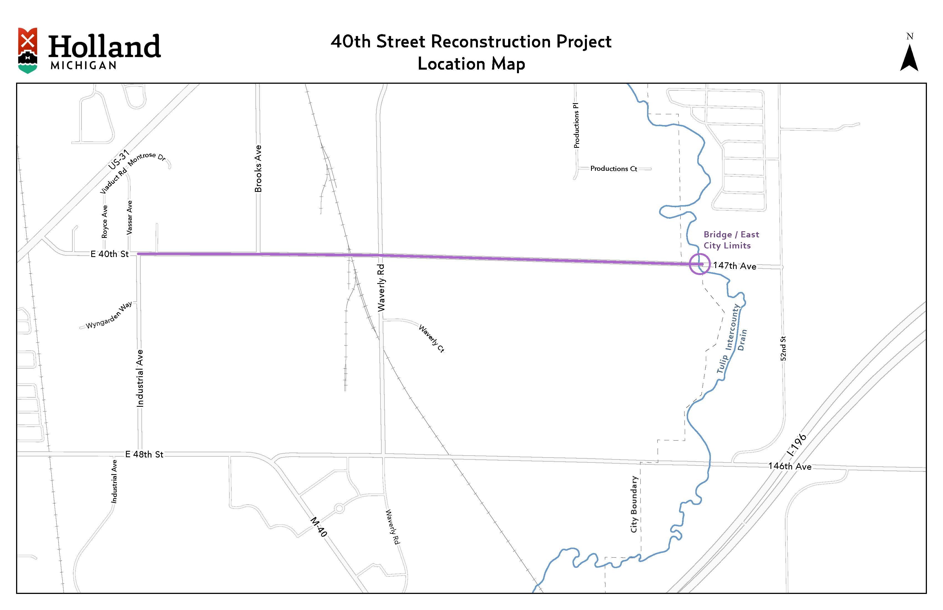

Slide 6
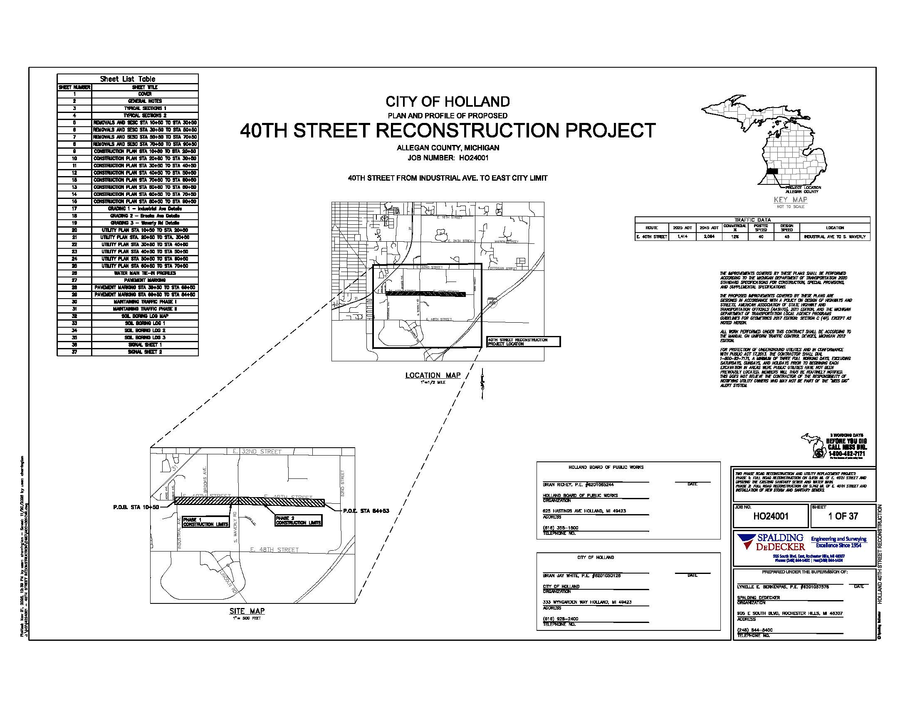

Slide 7
Scope
Extend 3 Lane Section on 40th Street to East City Limit
New Driveways to LG
Sanitary Sewer
Water Main
Intersection Improvements
Sidewalks

Slide 8
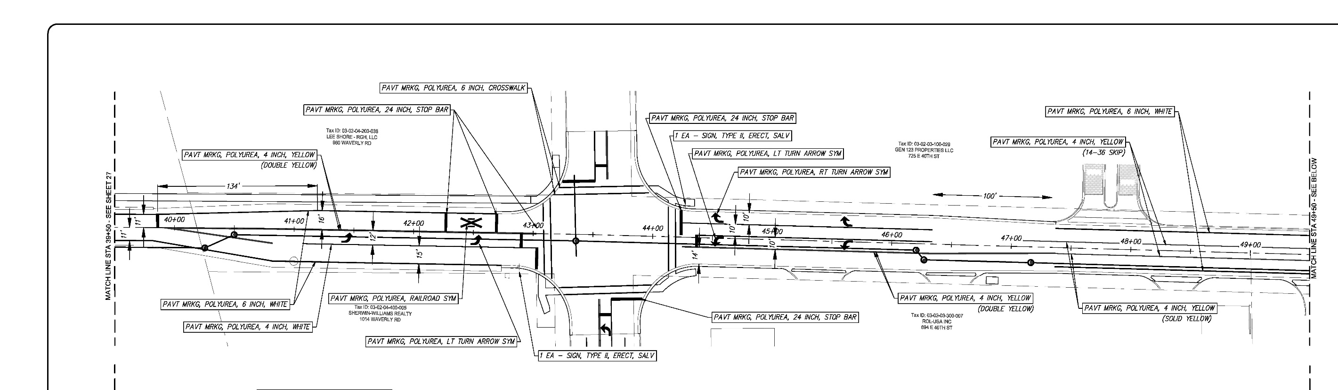
Scope

Slide 9
Funding
Grant Funding
Michigan Department of Transportation Economic Development Grant (TED category A funding)
$2.78 Million Grant
LG Funding
$6-7 Million Project
No assessments to local businesses / property owners

Slide 10
Expectations During Construction
Access to be maintained
Trash pickup / Trash pickup dates / Tape Address # on cans
Mail service to continue
Sprinklers
Utility Service Interruptions – Coordination / Advance Notice

Slide 11
Sprinkling Systems
Best to notify BPW/City ahead of time and flag if possible
Repairs can be completed by the Contractor familiar with your system
Estimate required before any work is performed

Slide 12
Tentative Schedule
Final Project Approvals
Bidding – January / February / March
Start Construction April / May (Phase #1)
Complete Construction October / November (Phase #2)

Slide 13
Wrap Up
Project post cards and contact information (24 hr. contacts)
Question & Answer for Group
One on One for Specific Questions

Slide 14
Thank You!!

